Slide 1
Econometrics Presentation
Demiao Sun
Notes:
Hi, this is Demiao. today I’d like to present a project that I did two years ago that is based on econometrics. I conducted this project myself with the guidance of the top-tier professor in labor economic.

Slide 2

Effect of Retirement on Health in China
Background
Dataset & Sample
Methodology
Result, Discussion & Future Research
Appendix
Notes:
So in this presentation, I would introduce the background of this research and the data that used for this research and also how I generated a sample for this research more importantly, how introduce the methodology the variables I used, experiment, design and assumption needed, and also estimation.
Also share the result of this research and his limitation and the opportunities for future research.

Slide 3
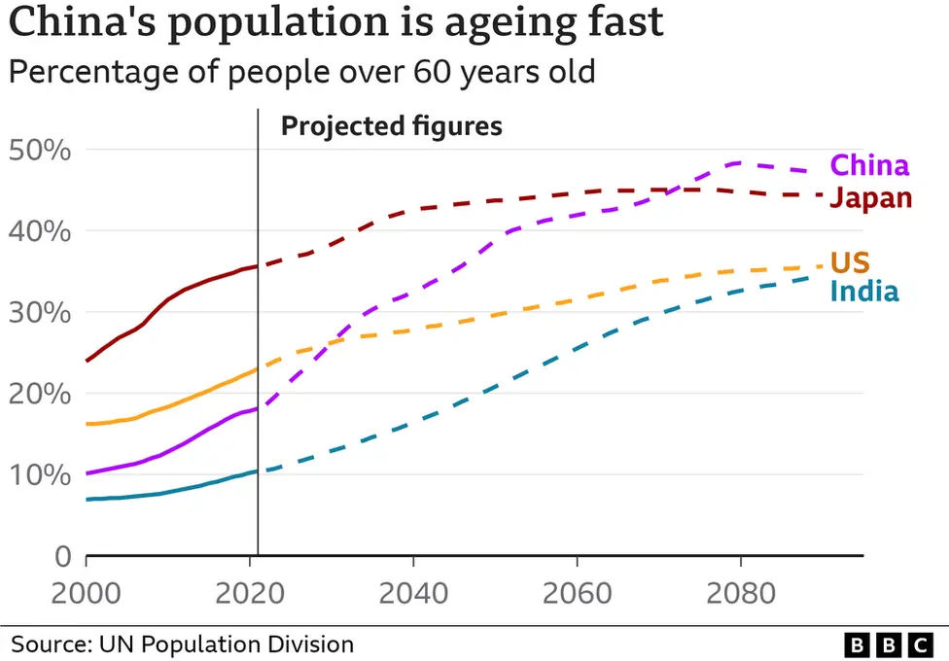
Background
Question
How does retirement affect health?
Answer
Estimated coefficient of retirement on health
Action
Reform retirement, pension and healthcare policies
Result
Healthier people, a sustainable pension system
Notes:
So China is a rapidly aging country and this causes pressure on our healthcare as well as the pension system. In this context, we want to ask how does retirement affect health, and we will have a quantitative answer.
with this answer at hand we can further reform our retirement， pension and healthcare policies so that we have Healthier people, sustainable pension system.

Slide 4



Dataset & Sample Preparation
CHARLS interviews people over 45 and their family members in China. The study started in 2012 and is conducted every other year. CHARLS dataset is an unbalanced panel dataset.
CHARLS is a world-renowned longitudinal field research, articles based on this field study are adopted by top journals worldwide.
I was an interviewer myself!
Random Sampling
Computers randomly select respondents
Interviewers are asked to use all means to interview the selected respondent
Supervision and Monitoring
Interviews are recorded and monitored by other volunteers
Selection Bias
Measurement Error
Notes:
reason why it’s so well recognized it because it has very rigorous interviewing process. The first of all is random sampling. The computers will randomly select respondents nation-wide. and the interviewers are asked to use all their means to interview the respondents. meanwhile, all the interviews are recorded and monitored by other volunteers to make sure the questions are correctly asked.
such rigoursou requirement help us avoid selection, bias, and management error and consequently help us to avoid endogeneity in the research.

Slide 5
Dataset & Sample Preparation
25,586 respondents
in total
Drop respondents who retired before 45
3,958 respondents left
Drop respondents not covered by the pension system
5,591 respondents left
Drop respondents whose working status is missing
3,702 respondents left
Drop observations of male <55 or >65
female <50 or >60
4,122 respondents left
3,702 respondents 10,227 observations
Notes:
So let’s move onto to introduce how we prepare the sample we used for the research so at first, we have 25,000 respondents in our data and we drop the respondents that are not covered by the pension system
later we drop observations of male and female that are in a certain range of age
and then drop respondents who retired before 45 and finally, we drop respondents whose working Status is missing. Finally, we got 3700 respondents in our data 10,000 observations.

Slide 6
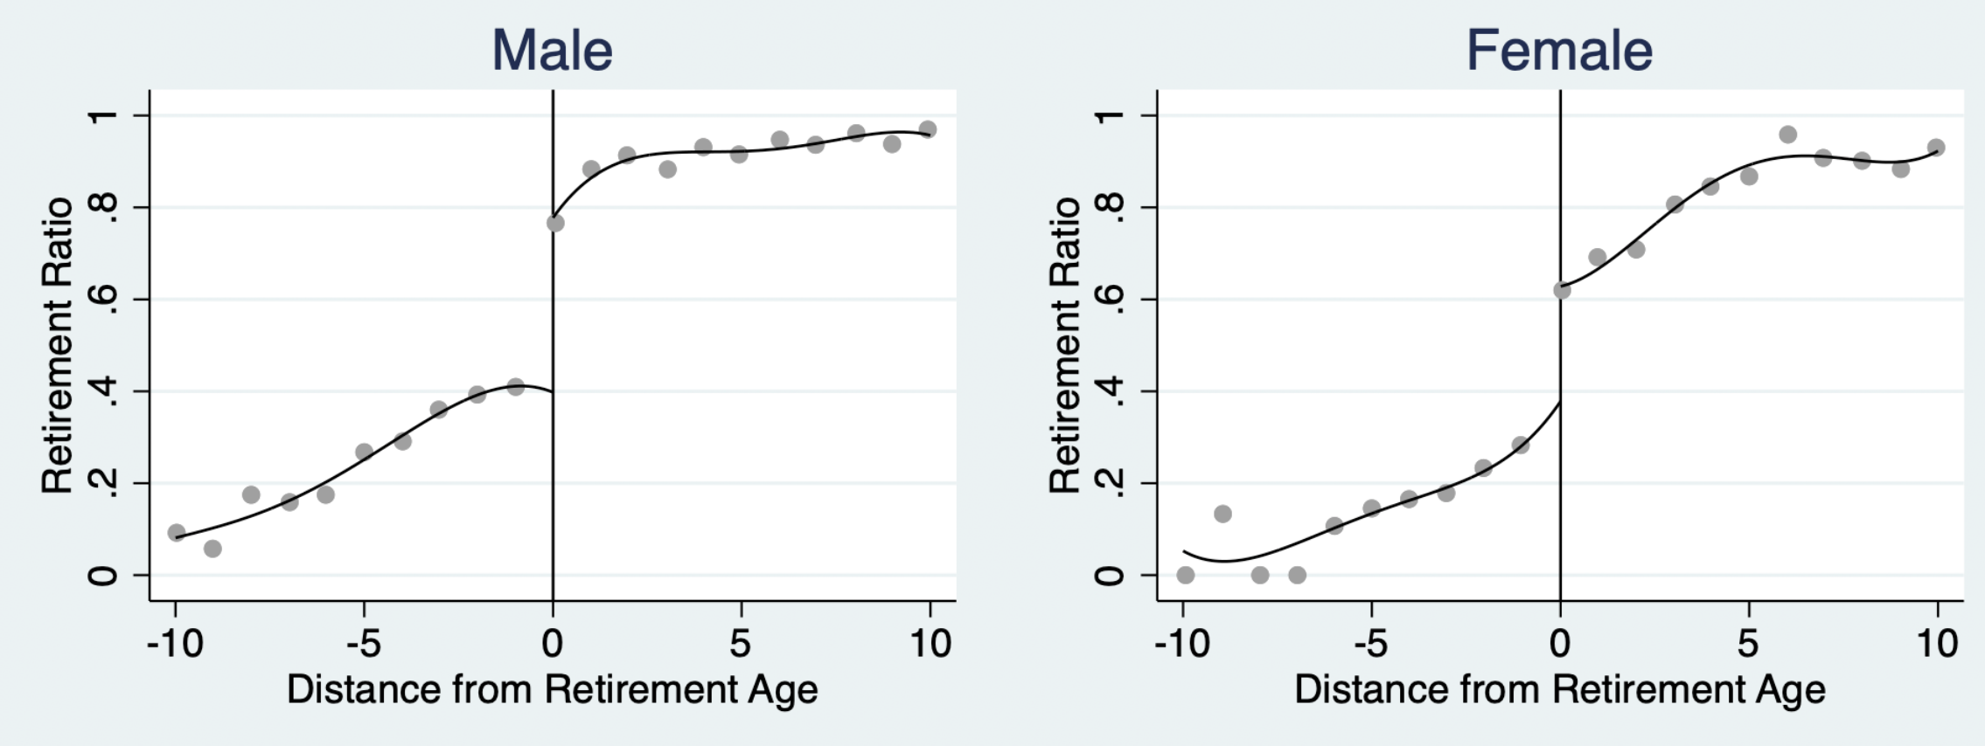
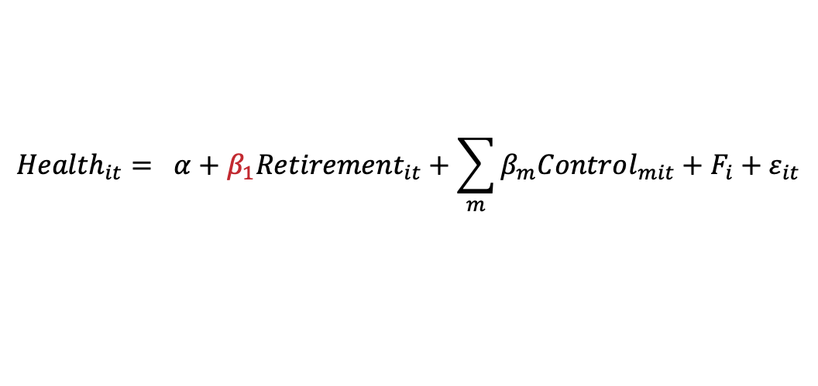
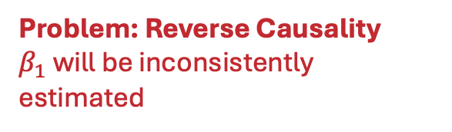
Methodology
Problem: Reverse Causality
$β_{1}$ will be inconsistently estimated
$${Health}_{it}= α+β_{1}{Retirement}_{it}+\sum_{m}{β_{m}Control_{mit}}+F_{i}+ε_{it}$$
Solution: Fuzzy RD
Male citizens begin to receive a pension at the age of 60, while female citizens at the age of 55.
Notes:
So let’s move onto the interesting part, methodology - experiment design
intuitively, we want to have one regression equation. By using the equation on the right hand side, we can just get how retirement affect the health outcome. However, if we give a second thought, we’ll find that Health can also affect retirement. people may decide to retire earlier if they are not healthy so this is what we call reverse causality and reverse causality will make beta1 be inconsistently estimated.
so here we will be using Fuzzy RD to solve this endogeneity problem. In China citizens that are covered by the pension system will begin to receive the pension at age of 60 if they are male and add age of 55 if they are female. crossing the cut-off will affect significantly the probability of retirement. as you can see on the right hand side plots

Slide 7
Methodology - Variable
Variable | Distribution | Explanation
Dependent Variables
Self-reported health | Binomial | Subjective assessment of the health status on a 5-grade scale, and converted to a dummy variable. The Cut-off is decided based on the literature review
Depression | Binomial | CES-D-10 score is calculated and converted to a dummy variable. The Cut-off is decided based on the literature review
Cognition | Gaussian | MoCA score is calculated based on the interviewee’s response
Variable of Interest and Instrumental / Forcing Variable
Retirement | Binomial | If the respondent reported as retired
If age above the cut off | Binomial | If male above 60 and female above 55
Notes:
And now let me introduce the dependent variable to define health we use three variables. The first is self-reported Health. It was initially five grade scale, and later we converted into dummy variables, the cut off is based on the literature review and we also use depression to define health, it was initially based in CSD 10 score and we converted into a dummy variable and a cut off is also based literature review. finally we use cognition, which is based down more score.
For the variable of interest, we use retirement and is a dummy variable, indicating whether the respondent has retired or not,
I used Fuzzy Regression Discontinuity in this research, so here we have an instrumental variable, or you may call forcing variable.
This indicates if the respondents age is above the threshold to receive a pension or not.

Slide 8
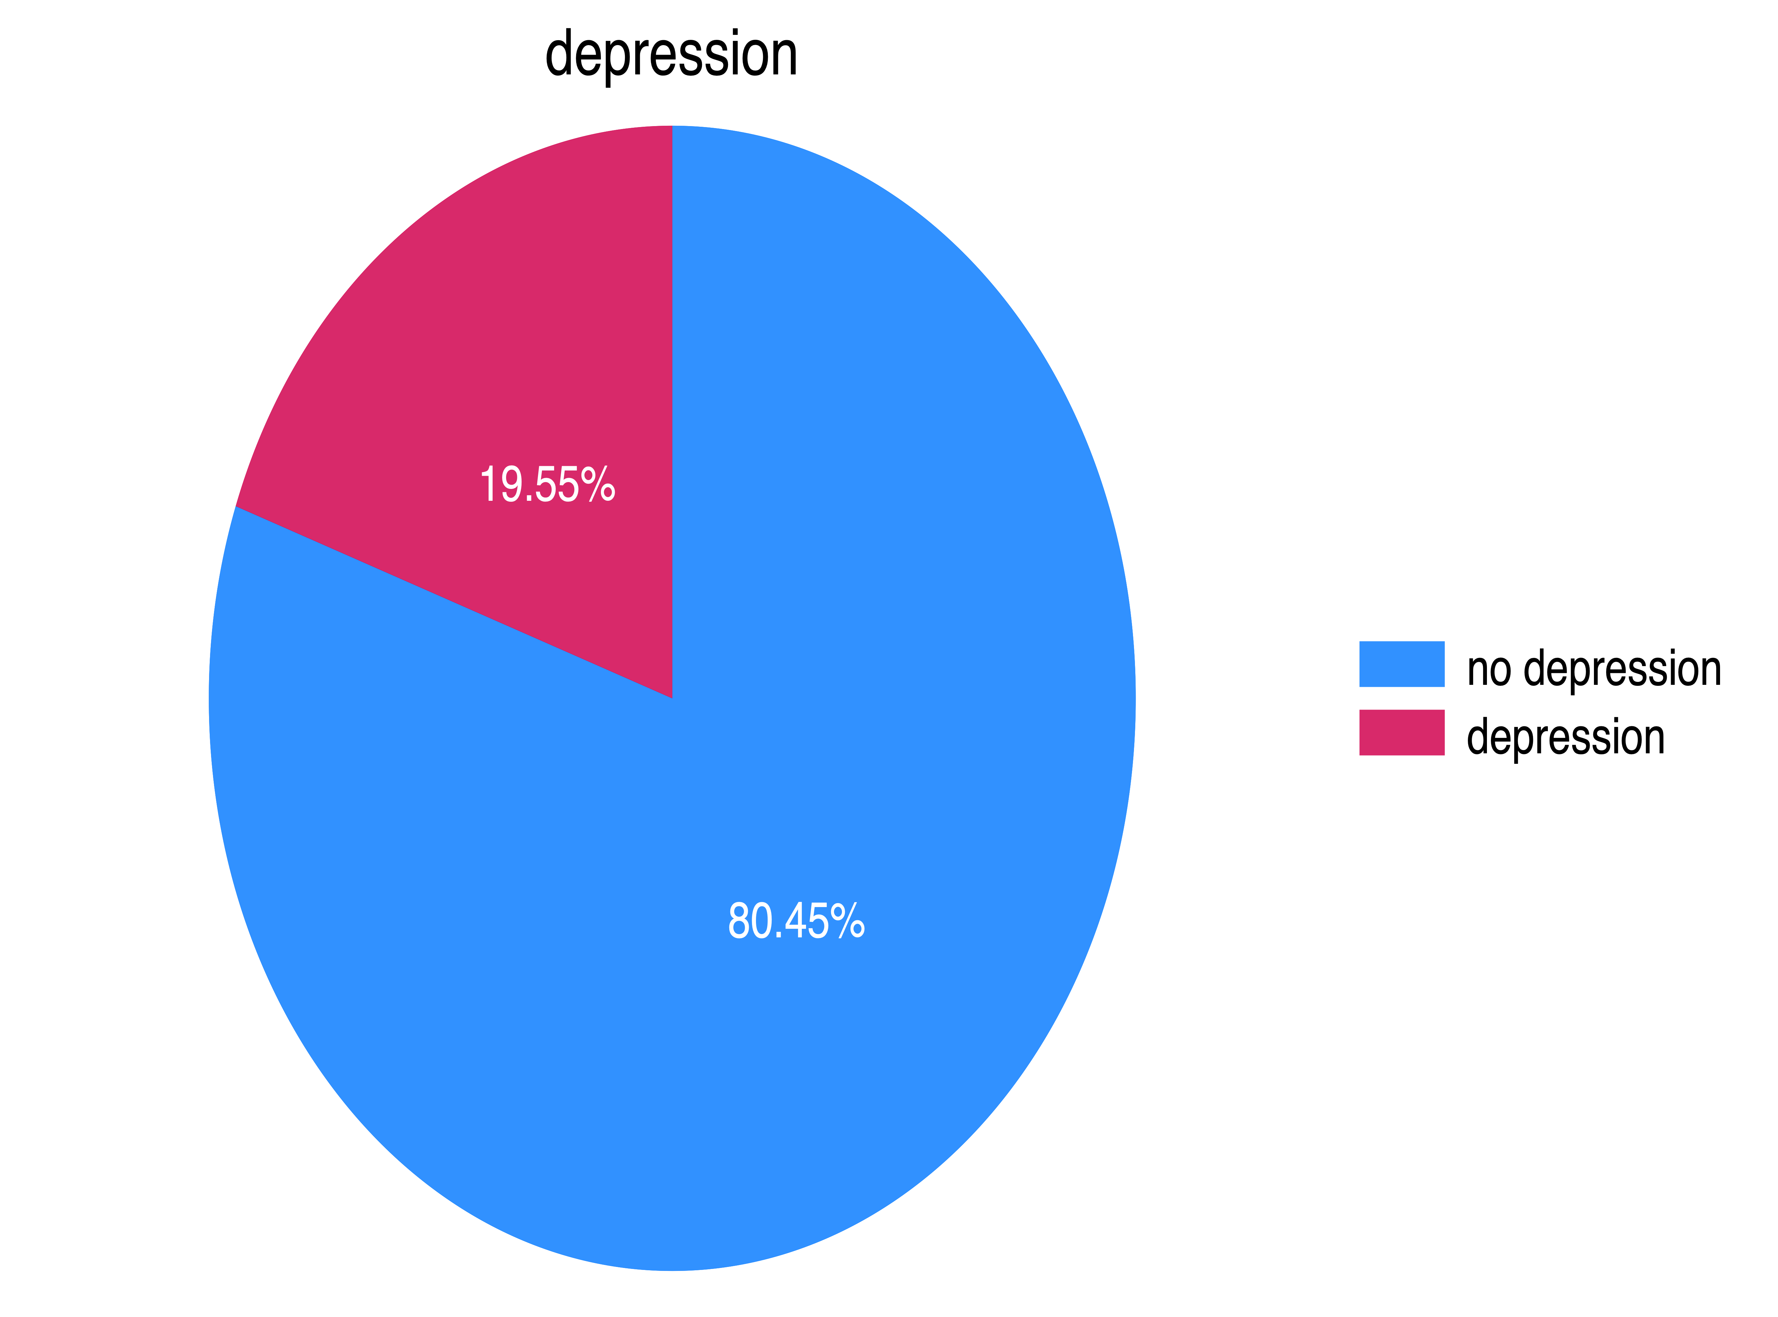
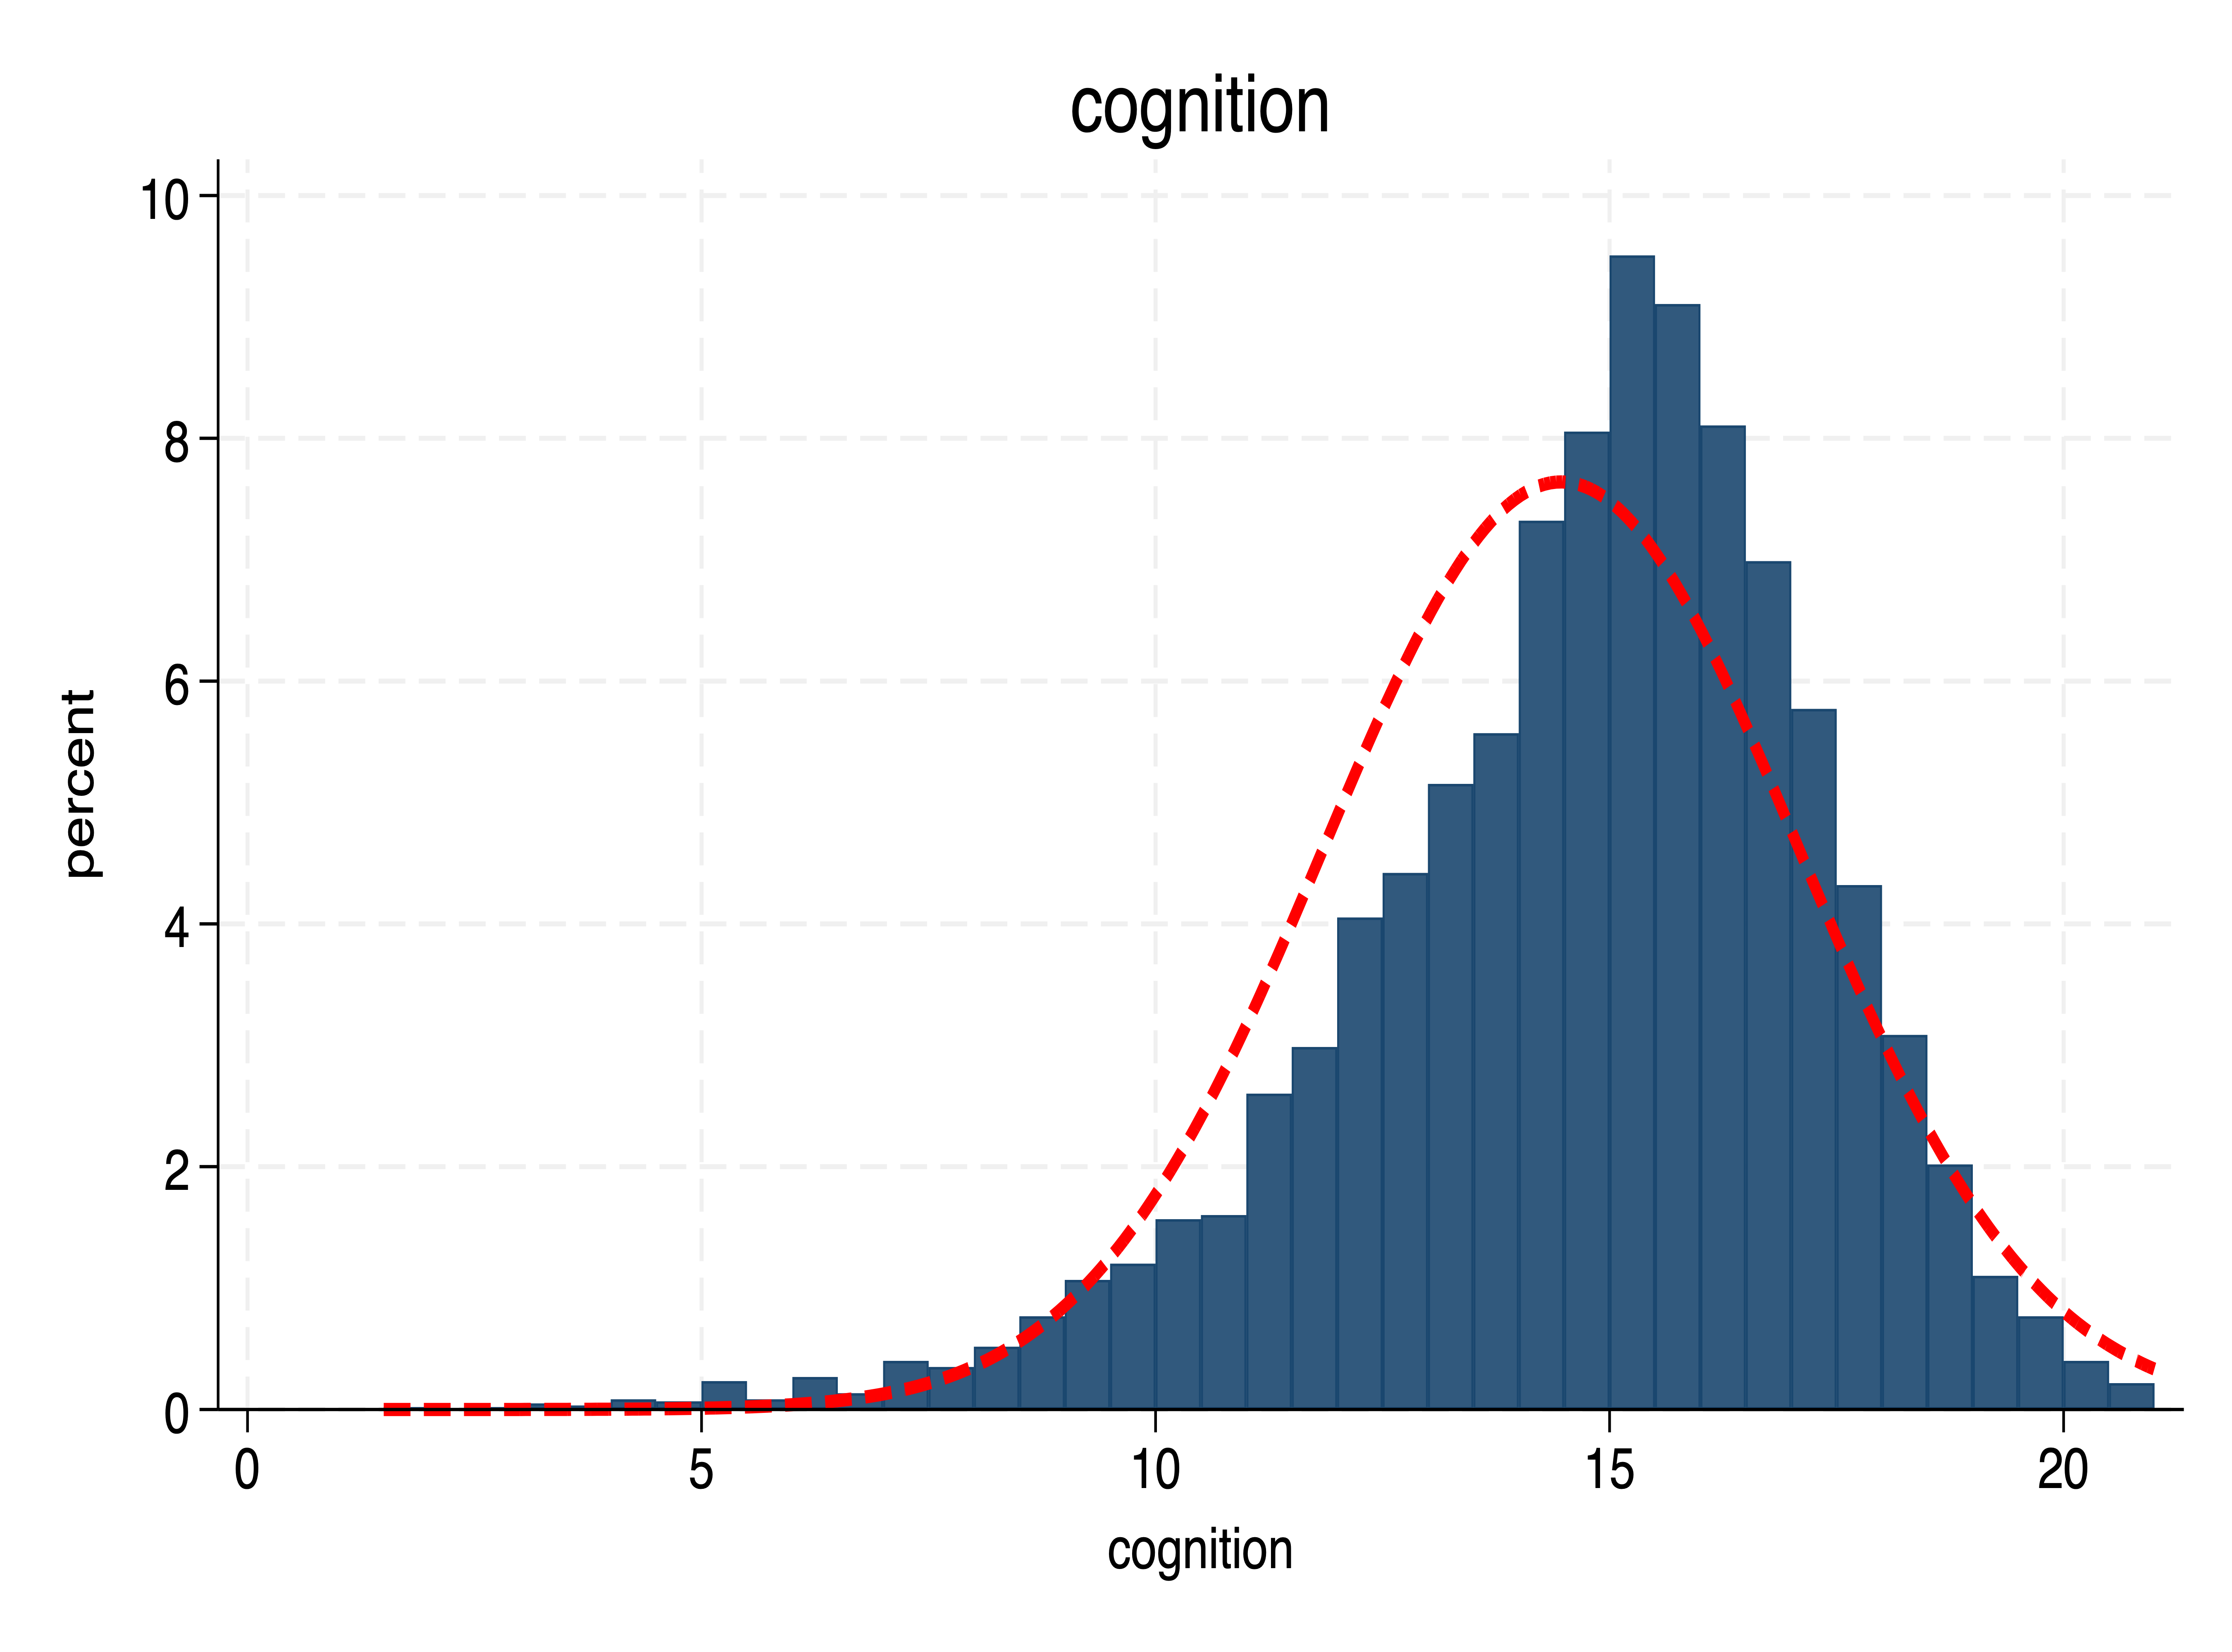
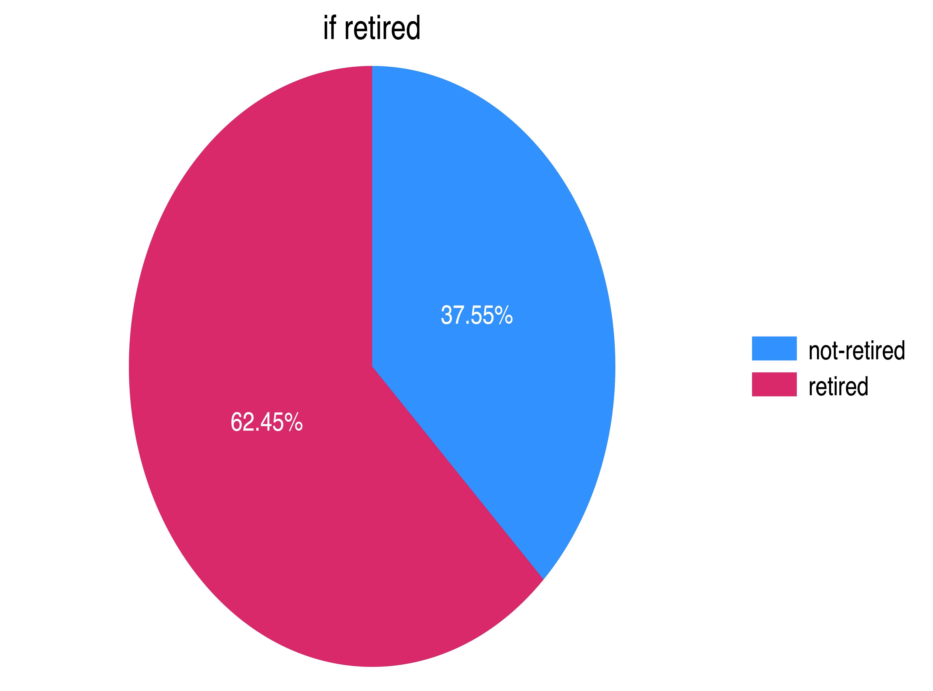
Methodology - Variables
Good, Very Good
Fair, Bad, Very Bad
No Depression
Depression
if above cut-off
Not Retired
Not Above Cut-off
Retired
Above Cut-off
Notes:
So this is the distribution of our dependent variable variable of interest and instrumental variable

Slide 9
Methodology - Variables
Controls
More control variables, higher R-square, more efficient estimates
Based on the panel dataset, individual fixed effects can be applied, which account for a time-invariant feature of each individual
Bad controls: mediators should not be included, i.e. drinking habits
Variables that are time-variant and not “bad control” to improve efficiency
Variable | Distribution | Explanation
Control Variable
Gender (group) | Binomial | Gender reported by the respondent
Age & age square | Gaussian | Age square is used to better control the non-linear trend
Hukou (Household Registration) | Binomial | Household Registration type, including rural and urban
Marital status | Binomial | Married and all others
Education | Binomial | Higher education and no higher education
Notes:
Since RD will be used, omitted variable bias is not our primary concern. So the purpose of including control variables is to improve the efficiency of estimates.
here are some considerations we need to think about when selecting good controls
also given we have a panel data at hand, we include individual fixed effect here, which accounts for the time-invariant feature of individuals.
Also, we need to avoid bad controls, for example, drinking habits.
So, what we need here is variables that are time-variant and not bad controls to improve efficiency.
we include, household registration type, education and marriage status. Those variables are time- variant, and are usually not considered impacted by retirement by our literature review.

Slide 10
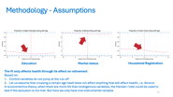
Methodology - Assumptions
1. No-manipulation / Random Assign
Individuals cannot perfectly manipulate their age
2. Relevancy
Reaching the cut-off causes the retirement probability to jump
3. Exclusion / Exogeneity
The IV only affects health through its effect on retirement, not through other variables
Notes:
Fuzzy RD is a special use of IV, and thus it has 2 assumptions required by IV, and one assumption required by RD
First, no manipulation, respondent cannot falsify their age to get earlier retired. and on the right hand side of the distribution, we did not observe any signs of age manipulation.
Relevancy, this IV is useful. We see there is a clearly jump of retirement probability at the cut off in the figure. IV is powerful enough to purify the variable of interest, retirement.
finally, exclusion

Slide 11
Methodology - Assumptions
Education
Marital status
Household Registration
The IV only affects health through its effect on retirement
Based on:
Control variables do not jump at the cut-off
Let us assume that crossing a certain age itself does not affect anything that will affect health, i.e. divorce
In econometrics theory, when there are more IVs than endogenous variables, the Hansen J test could be used to test if the exclusion is not met. But here we only have one instrumental variable
Notes:
those 3 variables are control varialbes, and those 3 plots are proportions of one of the values of the variable. There is no jump at the cut-off
Assumptions: the likelihood of a person decides to get …. only because this person crosses a certain age is very low.
In econometrics theory, when there are more IVs than endogenous variables,
the Hansen J test could be used to test if the exclusion assumption is not met. But here we only have one instrumental variable
with all assumptions being satisfied,
we move on to the estimation

Slide 12
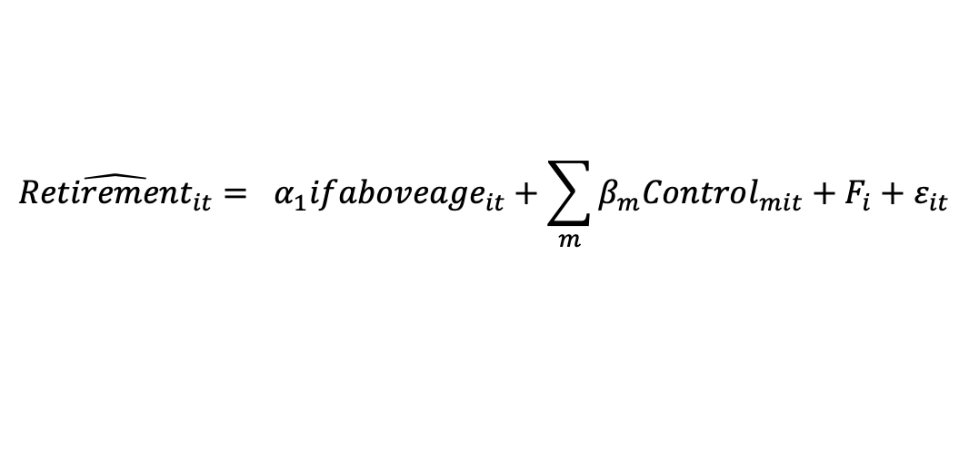
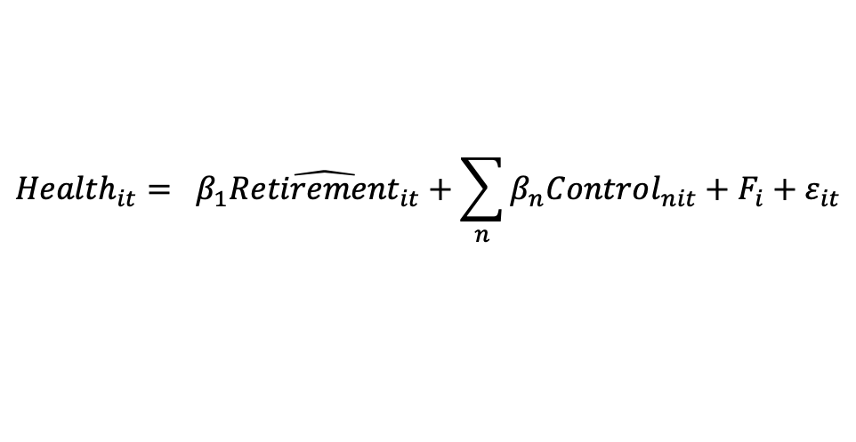
Methodology
$$\hat{{Retirement}_{it}}= α_{1}{ifaboveage}_{it}+\sum_{m}{β_{m}Control_{mit}}+F_{i}+ε_{it}$$
$${Health}_{it}= β_{1}\hat{{Retirement}_{it}}+\sum_{n}{β_{n}Control_{nit}}+F_{i}+ε_{it}$$
Estimation:
2-stage regression is applied here
Error:
Heteroskedasticity-robust error is used
Panel data, cluster-robust error for the clustering observations of each respondent
Notes:
As we discussed it before fuzzy request and discontinuity is a special use of instrumental variable so here we want to use two stage regression.
first stage we get the estimated retirement variable, and for the second stage, we use the health outcomes to regress on the estimated retirement variable
As for the Error term, error robust for heteroskedasticity. is used in the estimation.
Because it’s a panel dataset, so respondents have multiple observations. the observations of the same respondents belong to the same cluster. To restore the independence assumption, we need to use cluster-robust error.

Slide 13
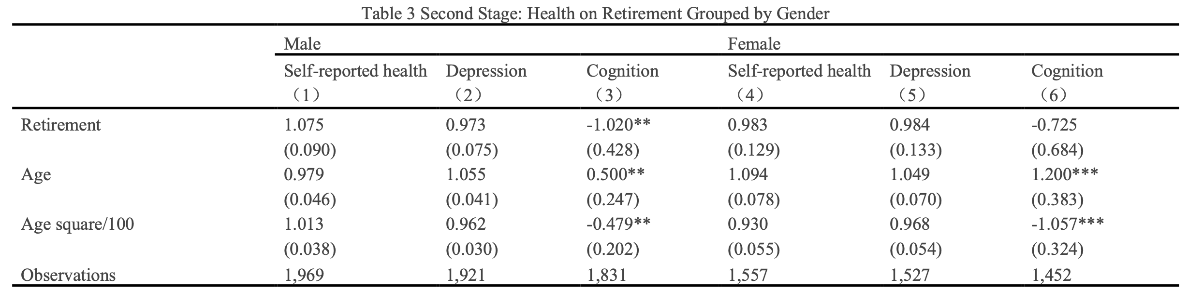
Result, Discussion & Future Research
Retirement will negatively impact the cognition of males
Notes:
retirement itself will reduce the MoCA score by 1.02 significantly

Slide 14
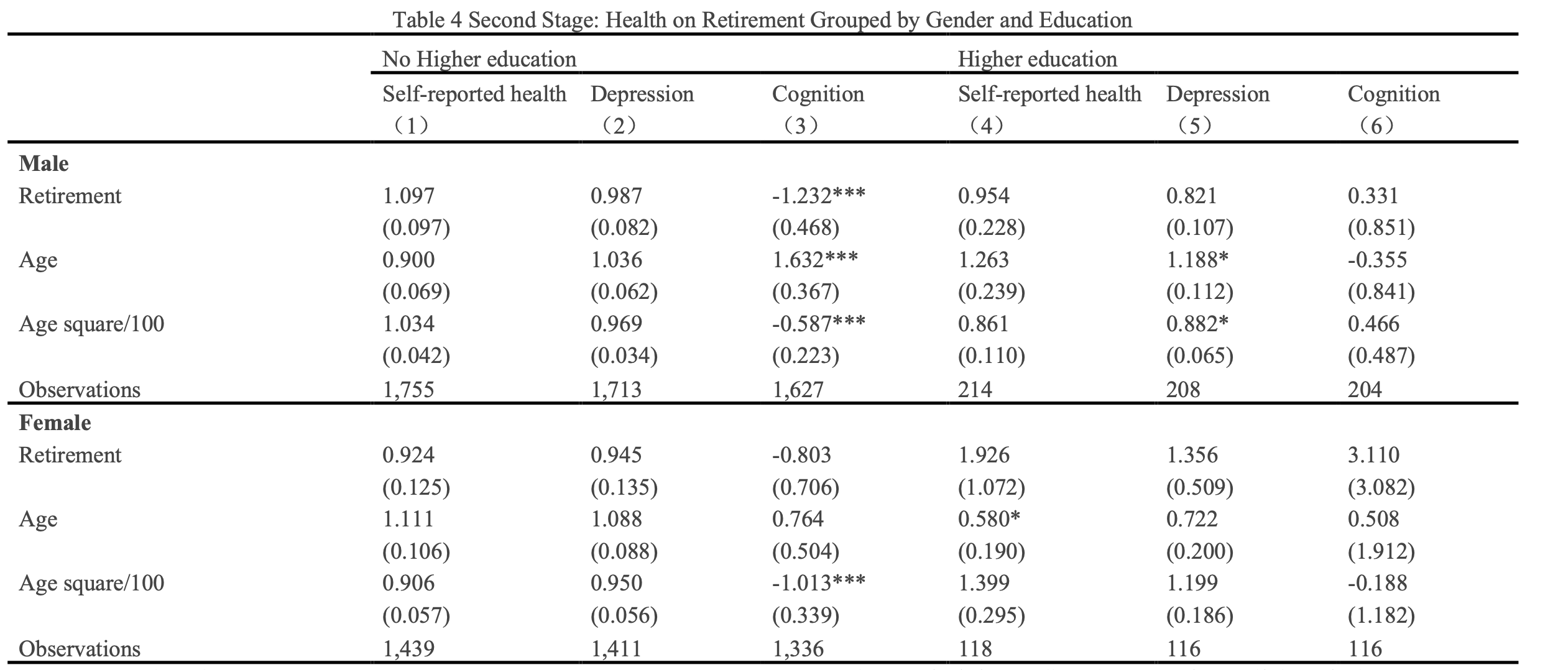
Result, Discussion & Future Research
Looking closer, retirement will negatively impact the cognition of males without a higher education experience
Notes:
retirement itself will reduce the MoCA score by 1.232 significantly .

Slide 15
Result, Discussion & Future Research
External Validity
the estimated coefficient is LATE, only valid to compliers, who work before the cut-off and retire after. The effect of retirement on health among people other than compliers is unknown and needs other experiment designs.
OLS vs. GLM Probit / Logit
While OLS does not assume y to be continuous, it is still worth trying to use the Probit / Logit estimation method
Control Variables
More time-variant, not “bad control” variables may be included in the regression to have more efficient estimates
Notes:
Logit and Probit results
which is easier to interpret
non-linearity

Slide 16
Appendix

Slide 17
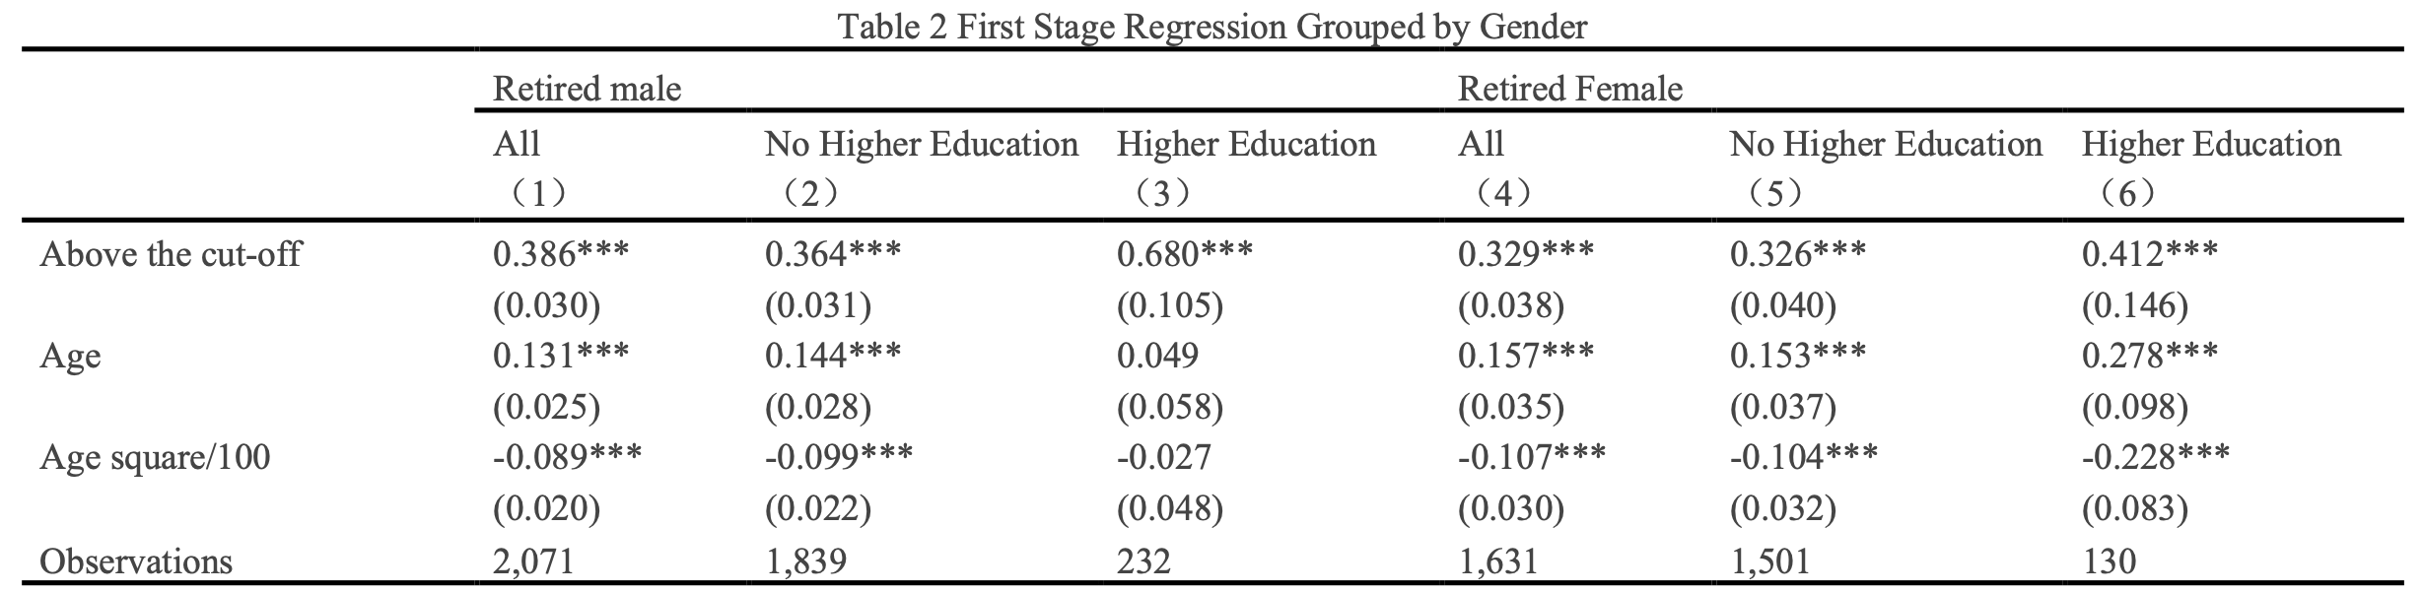
Relevancy Regression Table

Slide 18
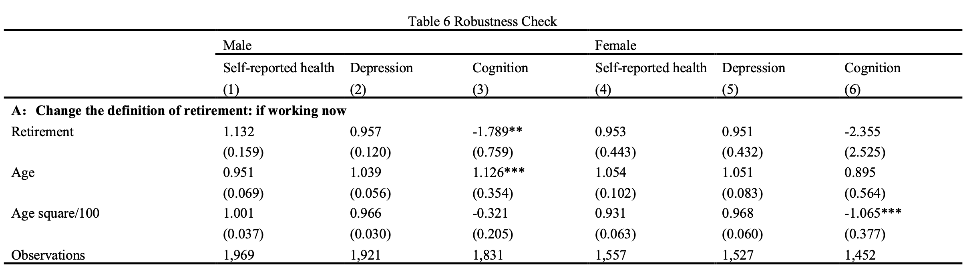
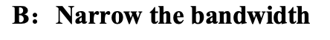
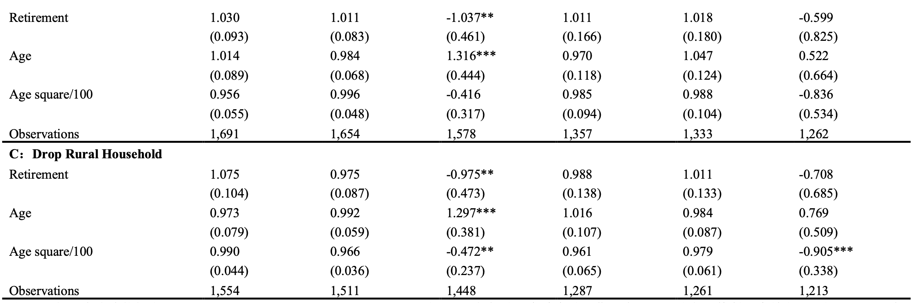
Robustness Check

Slide 19
Normality of the Error Term for Depression
Q-Q Plot for Male
Q-Q Plot for Female

